Slide 1
MY JOURNAL TO PYTHON
Name :蓋希娌
Teacher : My Dear Great Teacher

Slide 2
AGENDA
Python
Input and Output: input() and print ()
Data Types: Numeric, strings, lists, dictionaries.
Operators ON Data Types:

Slide 3
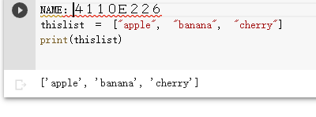
Data type : python list
List
Lists are used to store multiple items in a single variable.
Lists are one of 4 built-in data types in Python used to store collections of data, the other 3 are Tuple, Set, and Dictionary, all with different qualities and usage.
Lists are created using square brackets :

Slide 4
Examples :

